Slide 1
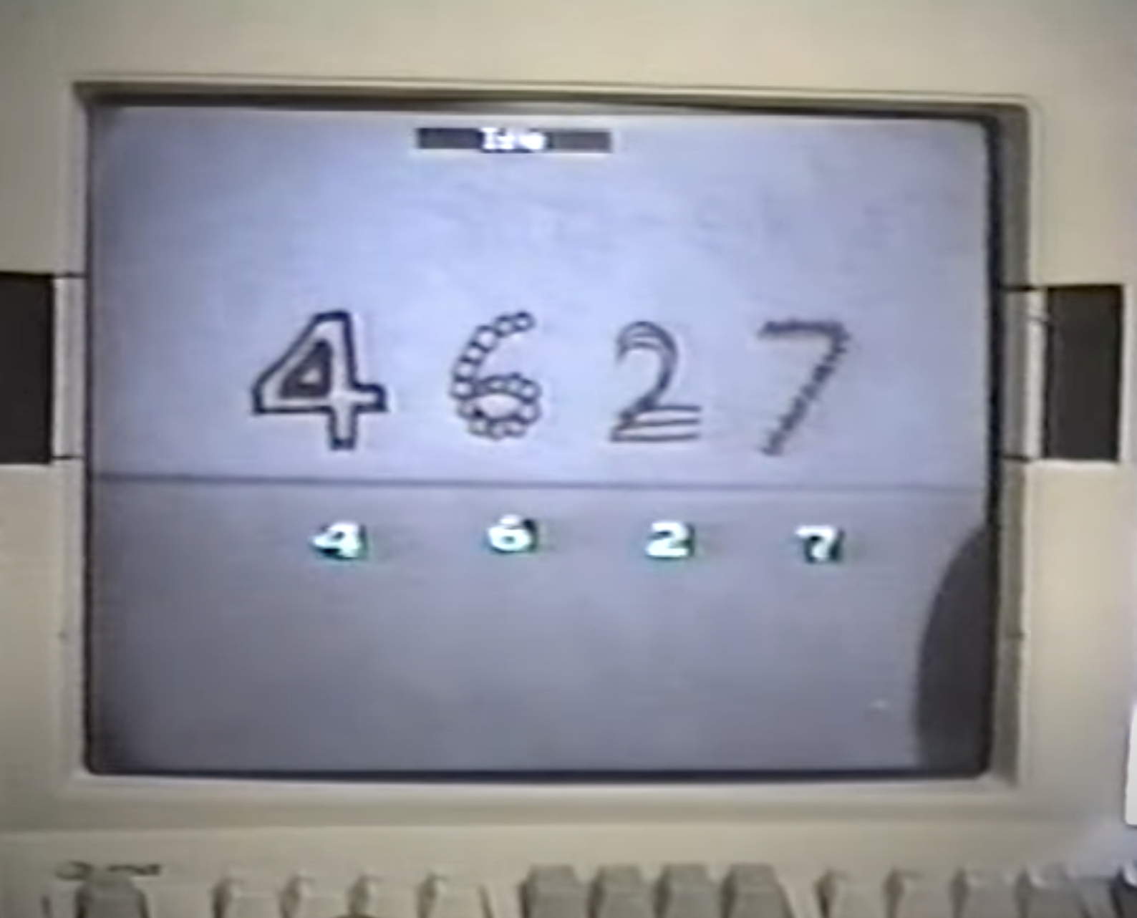
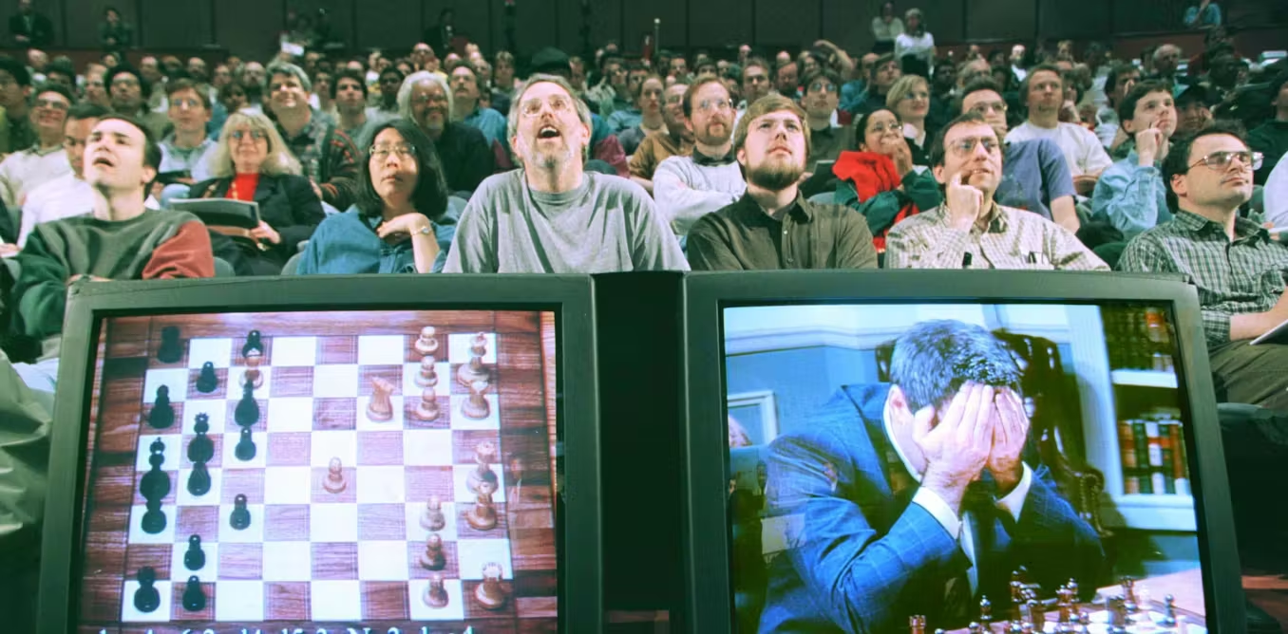

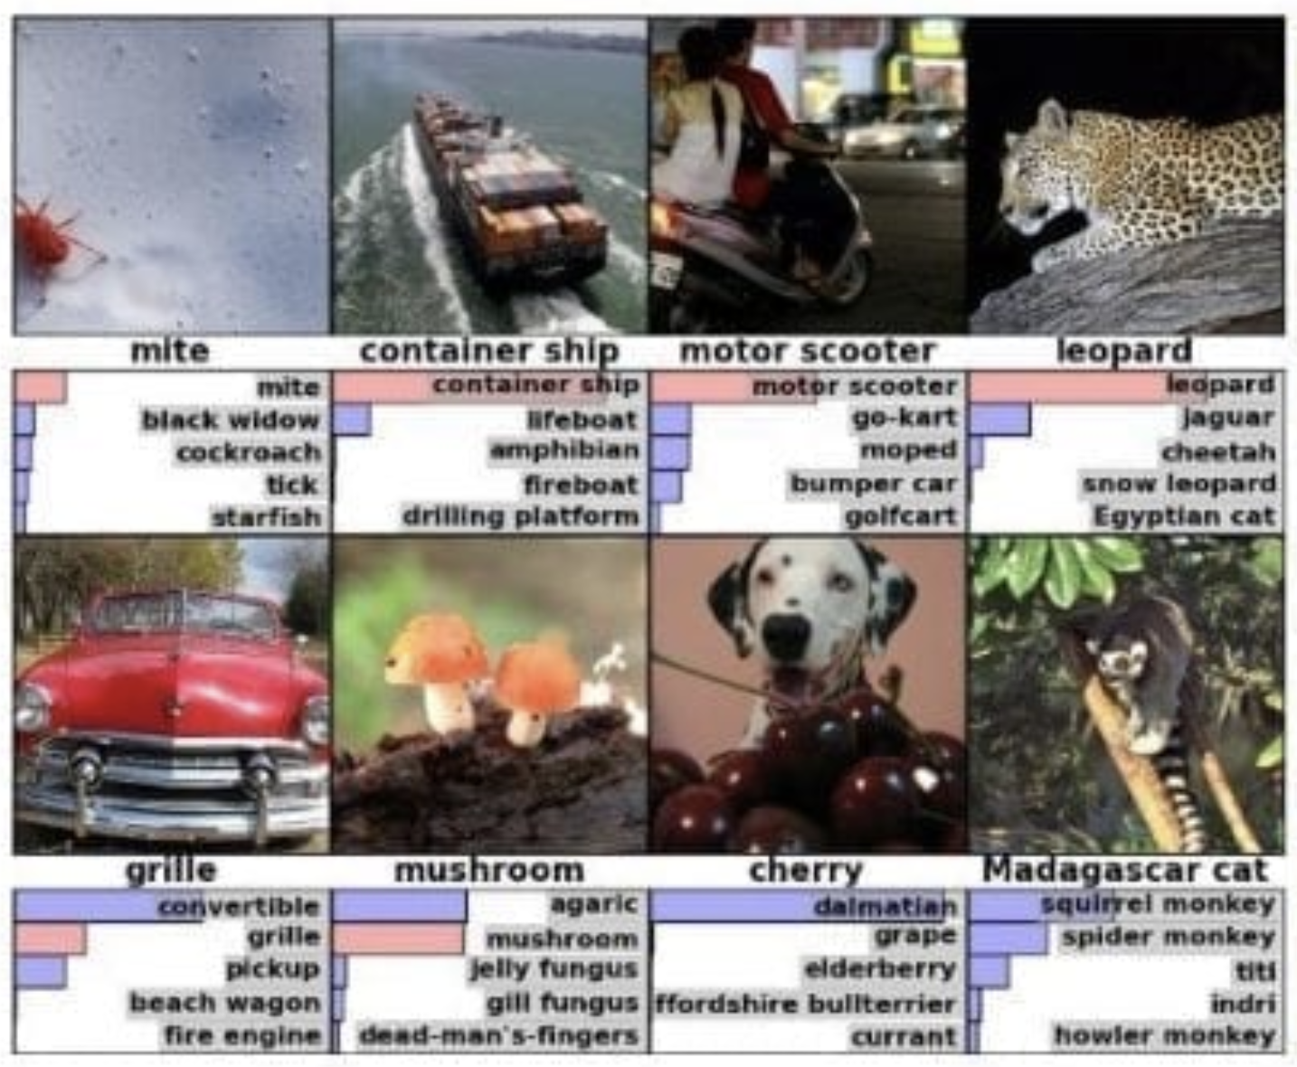


Slide 2
What will you learn?
What is AI and where do LLMs fit in the AI landscape
Basic intuition of LLMs work
Common pitfalls of using LLMs and why they happen

Slide 3
How will you learn this?
LLM model architecture
Common steps of training a basic LLM
Teach the LLM what a word/text is?
Teach the LLM how to speak
Teach the LLM how to answer questions and think
Generating useful outputs from a trained LLM
Let’s build an LLM from scratch!
Common pitfalls of using LLMs

Slide 4

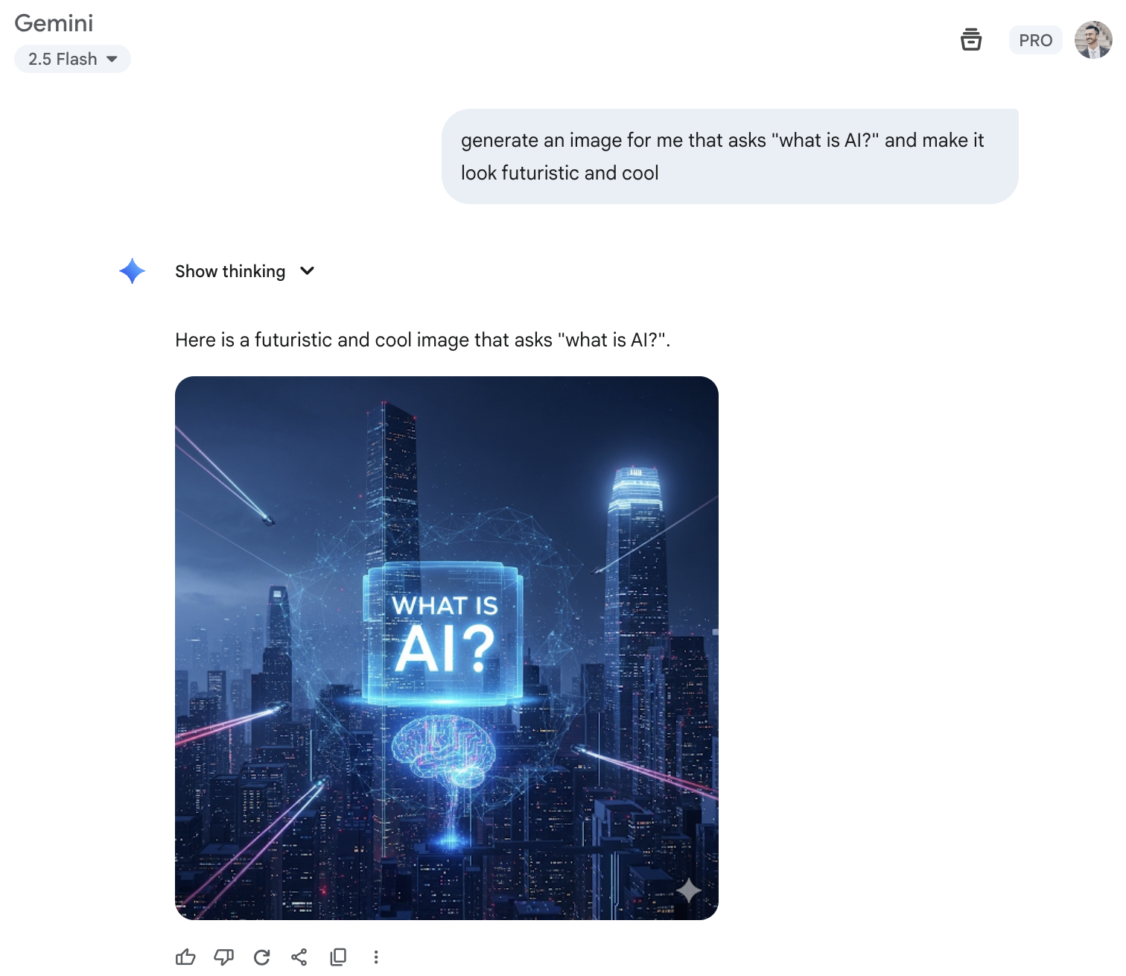
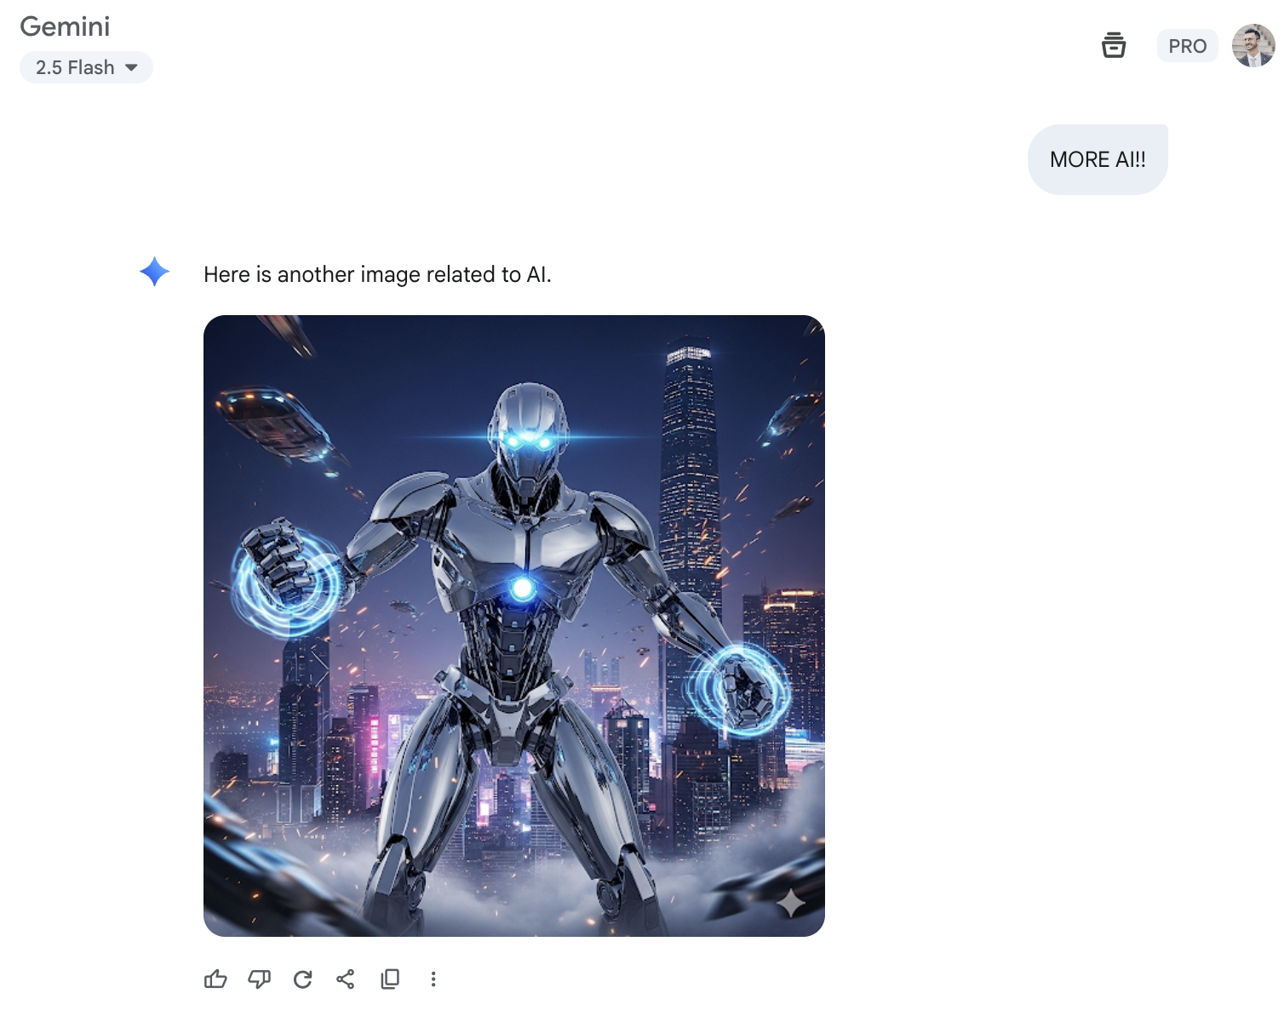
Notes:
This is what life would look like if you all just listen to Mari and restart your PCs every week
What have we learnt from this: ai is dark background, and lots of dark blue and purple

Slide 5
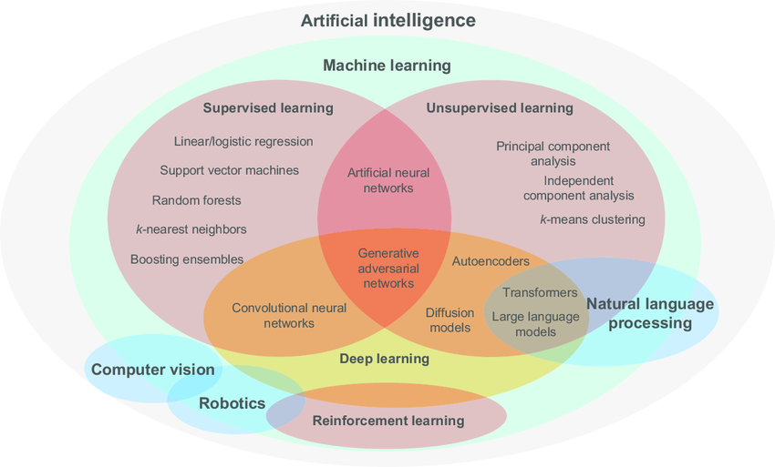
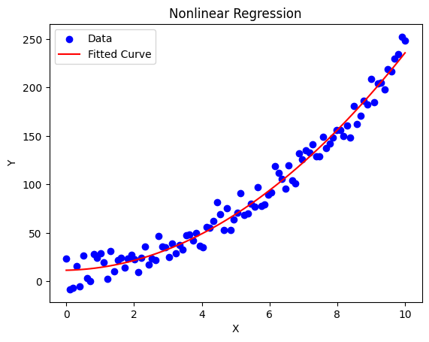
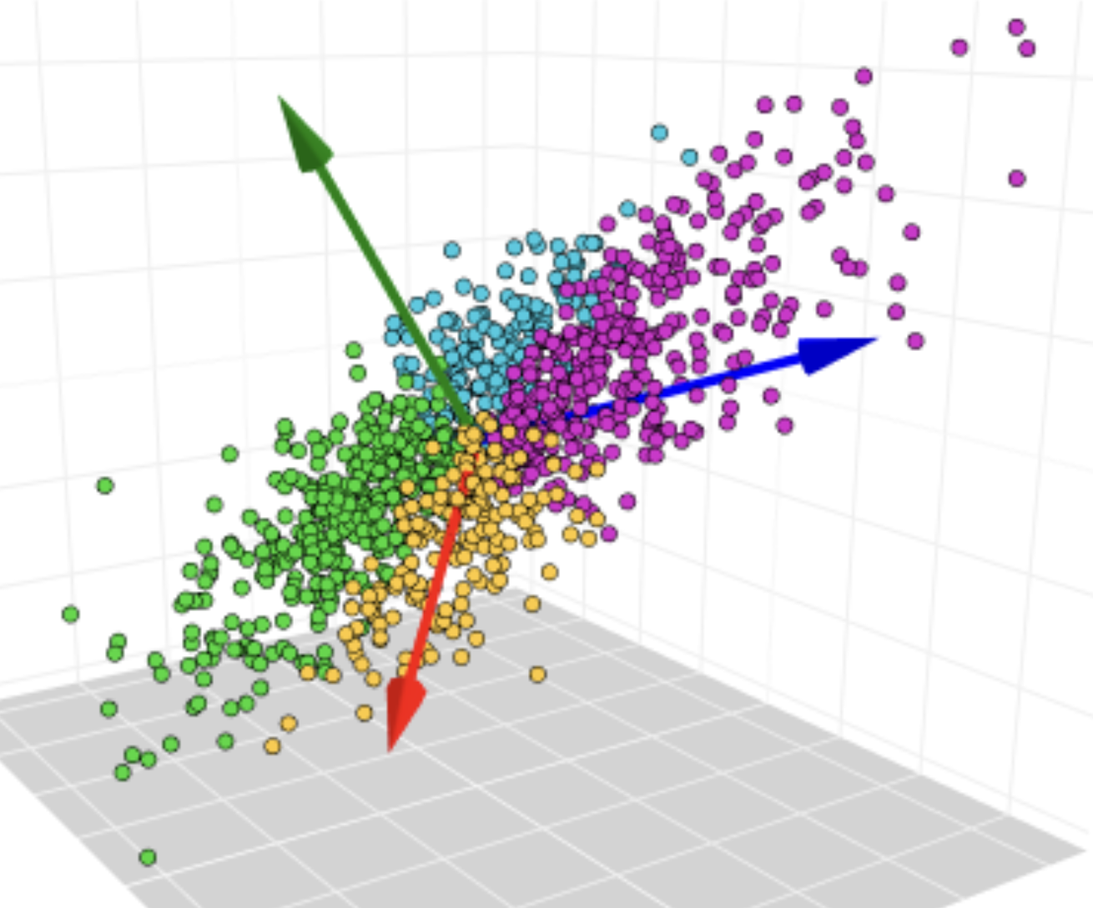
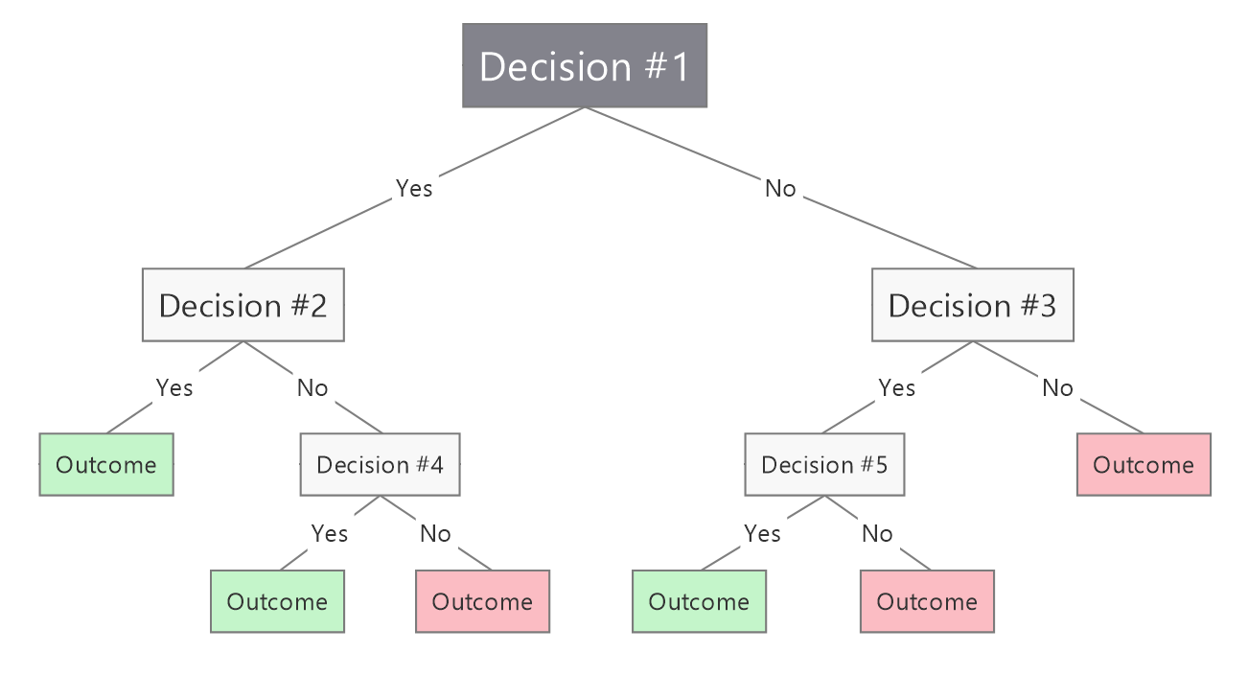
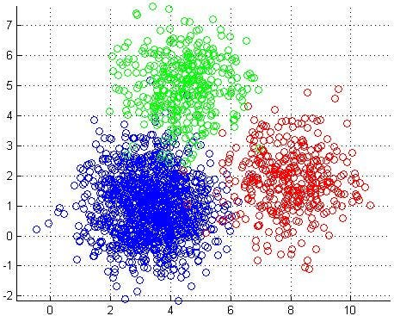
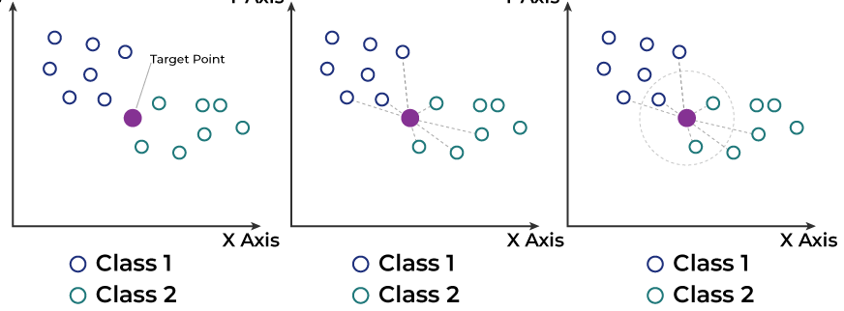

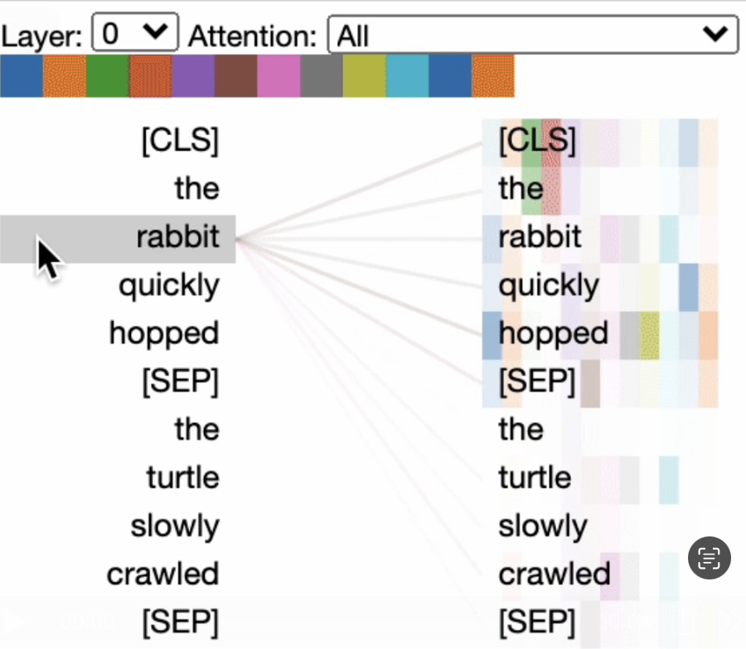
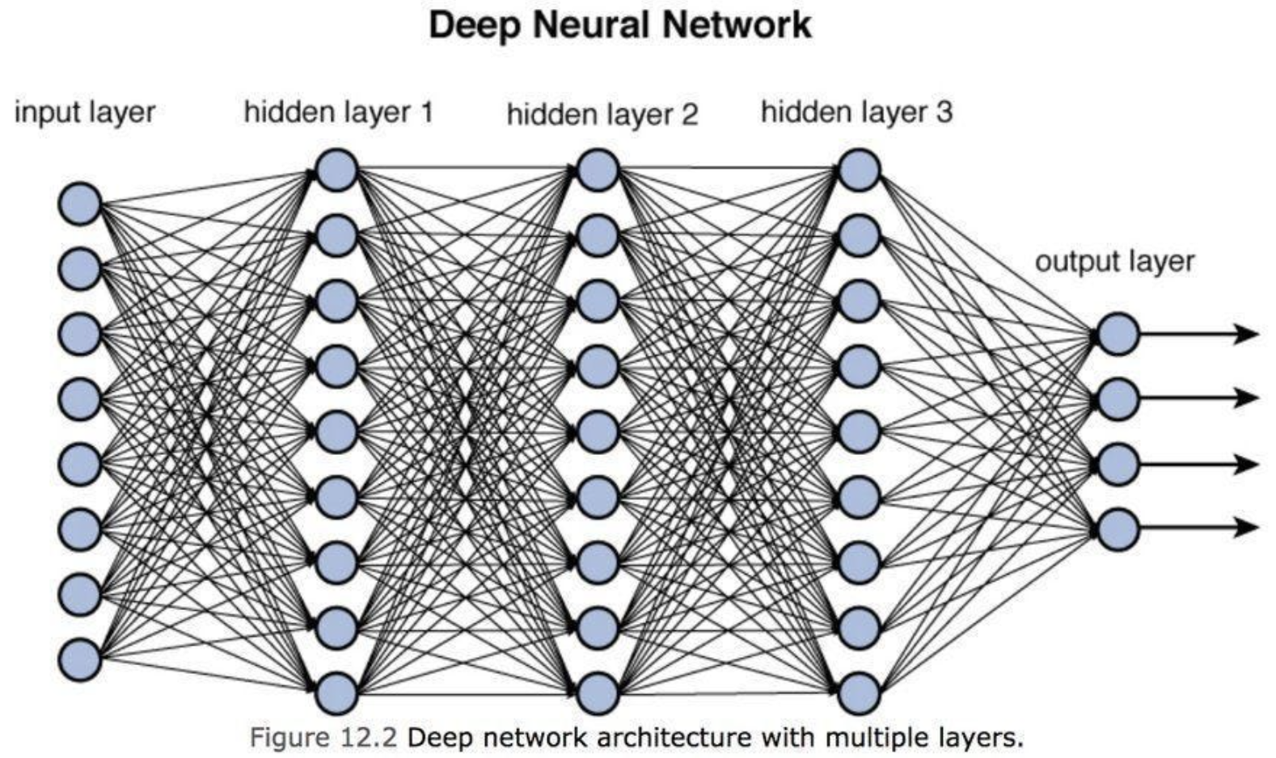
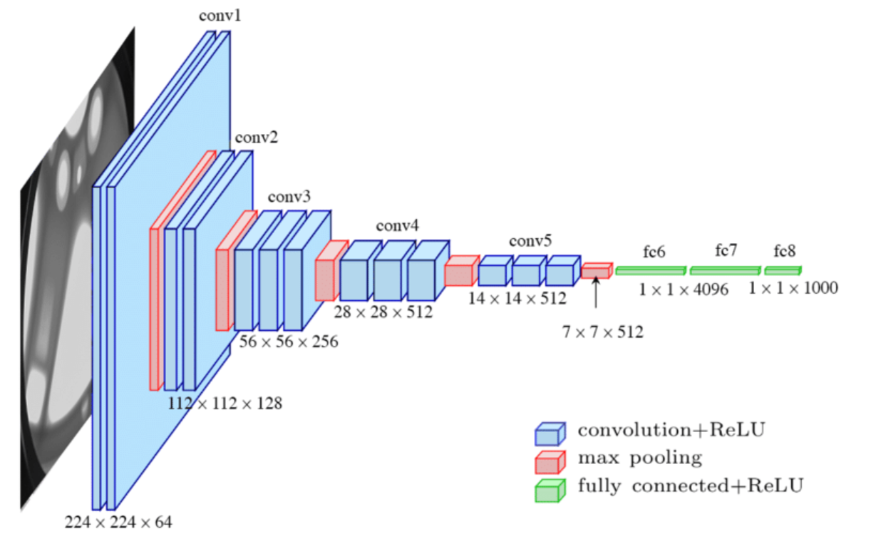
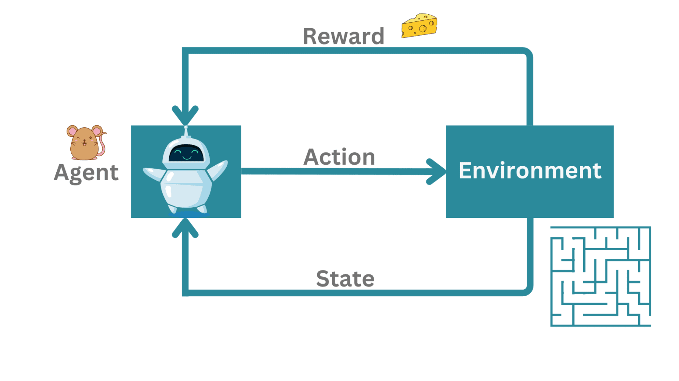

Slide 6
LLM model architecture
Common steps of training a basic LLM
Generating useful outputs from a trained LLM
Let’s build an LLM from scratch!
Common pitfalls of using LLMs

Slide 7
1. LLM model architecture
a

Slide 8
How will you learn this?
LLM model architecture
Common steps of training a basic LLM
Generating useful outputs from a trained LLM
Let’s build an LLM from scratch!
Common pitfalls of using LLMs

Slide 9
2.1 Training: Tokenization - Teach the LLM what a word/text is?

Slide 10
2.2 Pre-training - Teach the LLM how to speak
create an autocomplete with factual knowledge

Slide 11
2. Common steps of training a basic LLM
Post-training

Slide 12
How will you learn this?
LLM model architecture
Common steps of training a basic LLM
Generating useful outputs from a trained LLM
Let’s build an LLM from scratch!
Common pitfalls of using LLMs

Slide 13
3. Generating useful outputs from a trained LLM

Slide 14
How will you learn this?
LLM model architecture
Common steps of training a basic LLM
Generating useful outputs from a trained LLM
Let’s build an LLM from scratch!
Common pitfalls of using LLMs

Slide 15
4. Let’s build an LLM from scratch!
Tokenization
Pre-training
Post-training
Generating responses

Slide 16
How will you learn this?
LLM model architecture
Common steps of training a basic LLM
Generating useful outputs from a trained LLM
Let’s build an LLM from scratch!
Common pitfalls of using LLMs

Slide 17
5. Common pitfalls of using LLMs
Which of these should LLMs be Good vs Not Good at?

Slide 18
Summary

Slide 20
